Slide 1
Personal Expense Tracker
By: Alex, Laith, Nixon

Slide 2
Abstract:
Personal Expense Tracker Abstract: In today’s society it is so easy to loose track of where your money is going. A subscription charge, gas, food, and a random bill here and there. By creating an app that allows you to budget you can keep track of those random charges and take control of your expenses. Budgeting will allow you to have more freedom and a sense of peace. This app will be able to keep track of your expenses, the amount of money you have, and allow the user to view detailed spending reports with ease. Members: Alexander Crespo, Laith Saleh, Nixon Okiomeri

Slide 3
How it works
The Expense Tracker project is a simple yet effective tool that helps users manage and visualize their finances. It uses base python scripts to handle data and we utilized libraries like numpy and tkinter to help create user interfaces. The main script, ExpenseTracker.py, processes financial data from CSV files, organizing it into categories for easy analysis. Another script, Category.py, helps in managing these categories, allowing for detailed tracking. The user interface, created with the tkinter library in app.py, lets users load their financial data, choose categories, and view their expenses in pie charts, making it easier to understand spending patterns. This setup provides a straightforward way for users to keep track of their finances in a visual and interactive manner.

Slide 4
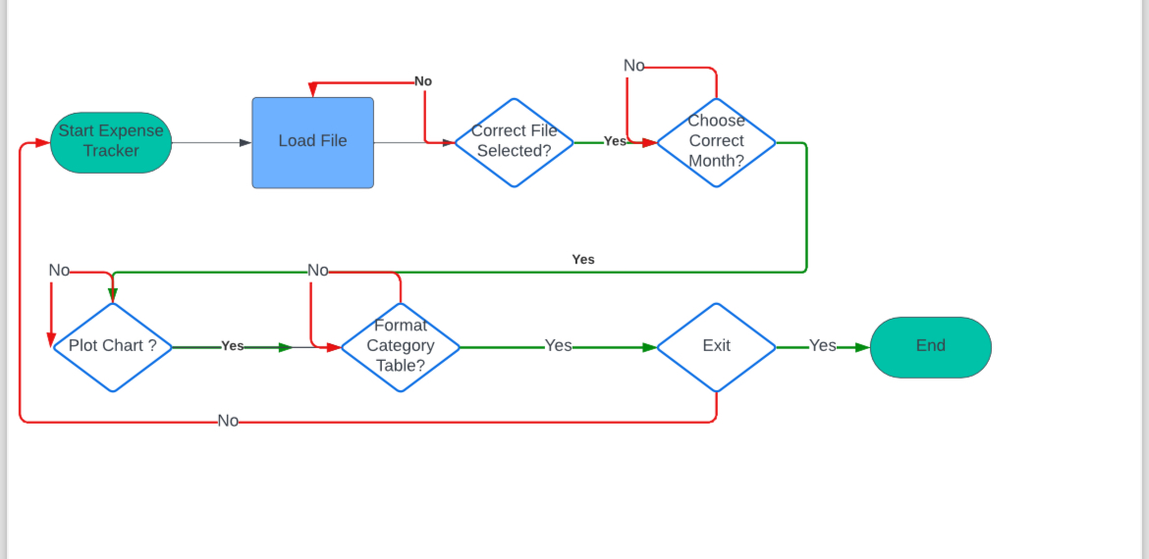

Slide 5
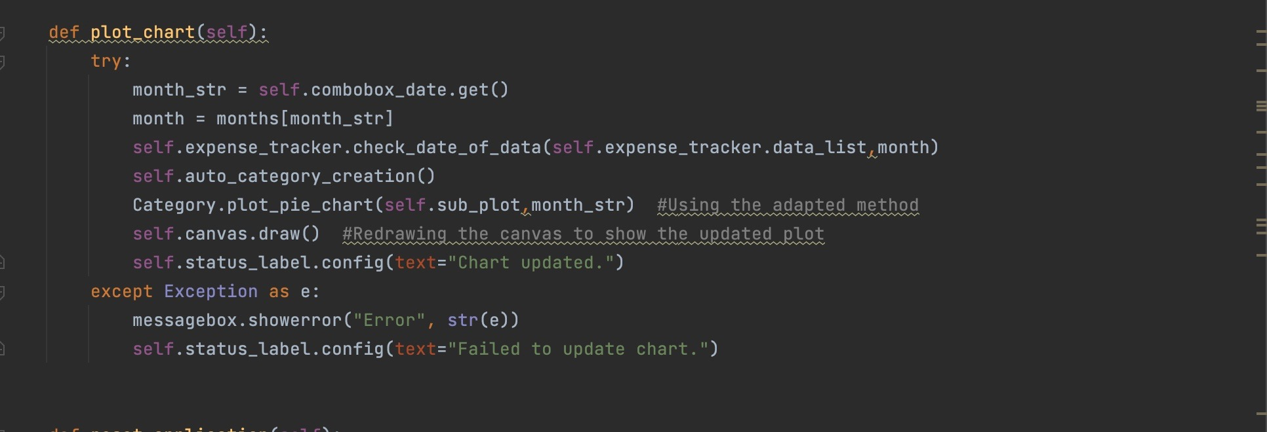
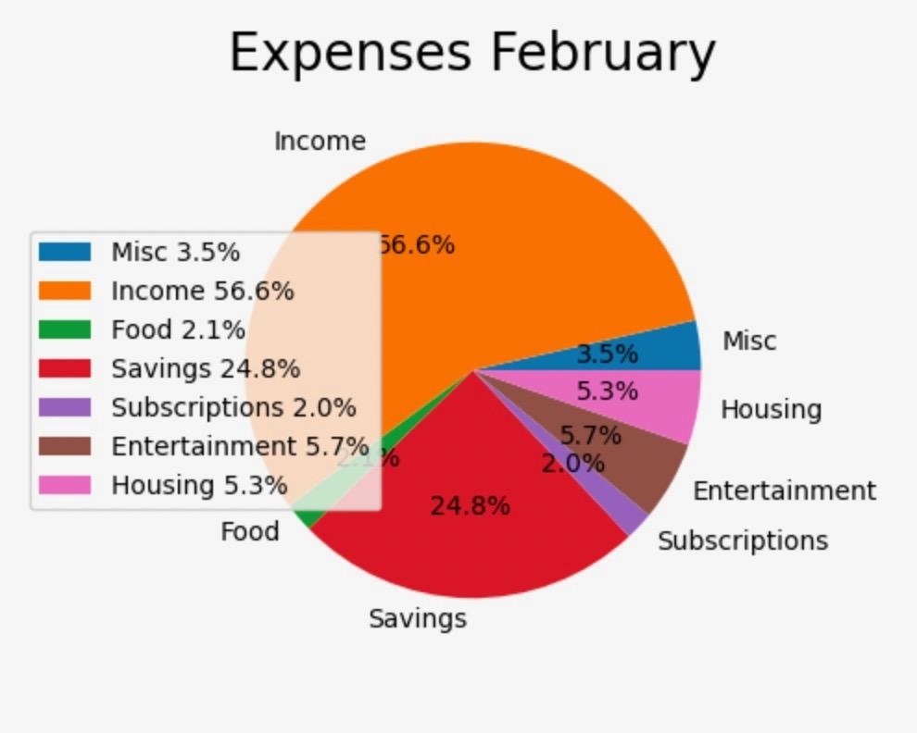
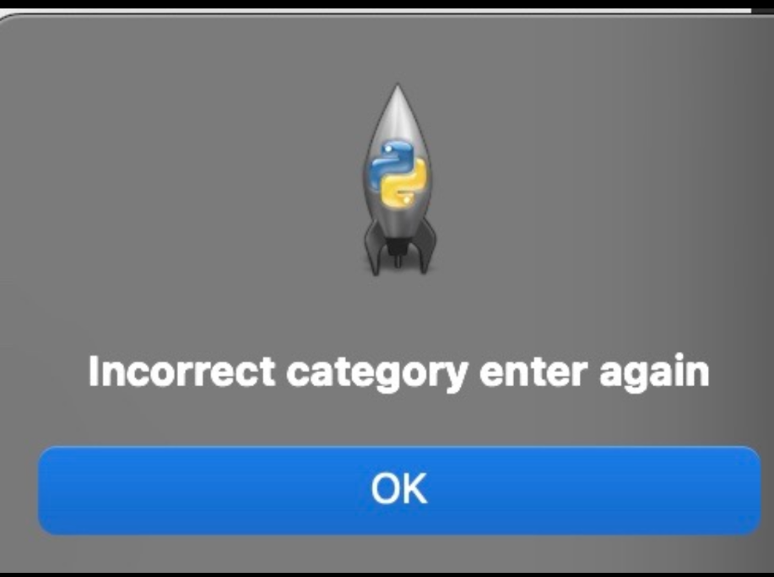
Important Functionalities (just pie chart for now)
This is the source code for the pie chart
(will go more in depth later)
The popup for error handling>

